Slide 1

(Vitamin) The C++
Tamás Toma
Full stack developer
Infrastructural Engineer
2023.11.03 Budapest

Slide 2

Summary
01
02
C++ in general
C++ syntax
PostOffice
OOP dojo

Slide 3
C++ in general
Procedural and OOP language
Similar to C
Developed by
Bjarne Stroustrup at Bell
In 1979
“C with classes, ” = C++,
from 1983
C++ is still the 3rd popular programming language
Platform dependent
The C++ compiler converts the source code into machine code and therefore, it is platform dependent.
From 2019

Slide 4
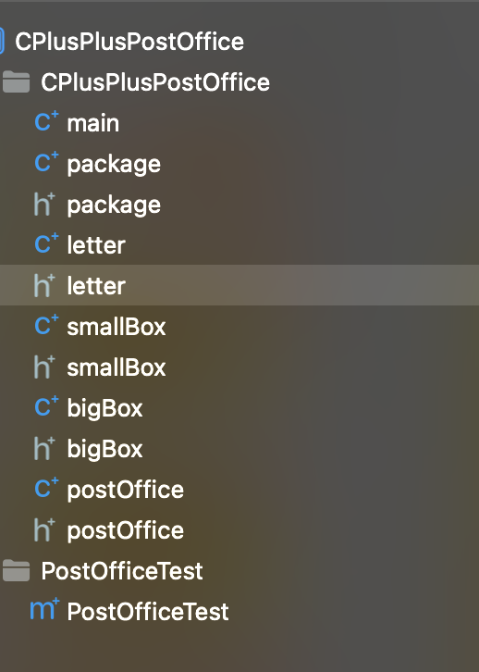
C++ files - root
Modularity
Abstraction

Slide 5
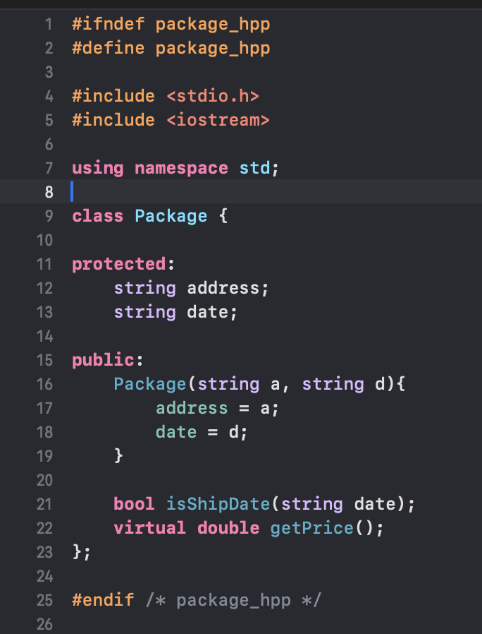
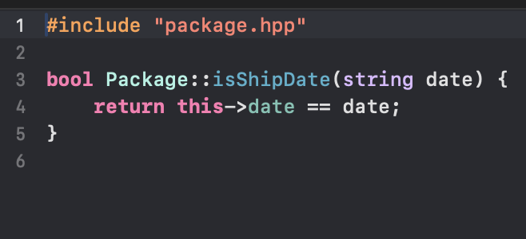
C++ files - Package
a .HPP file
a .CPP file

Slide 6
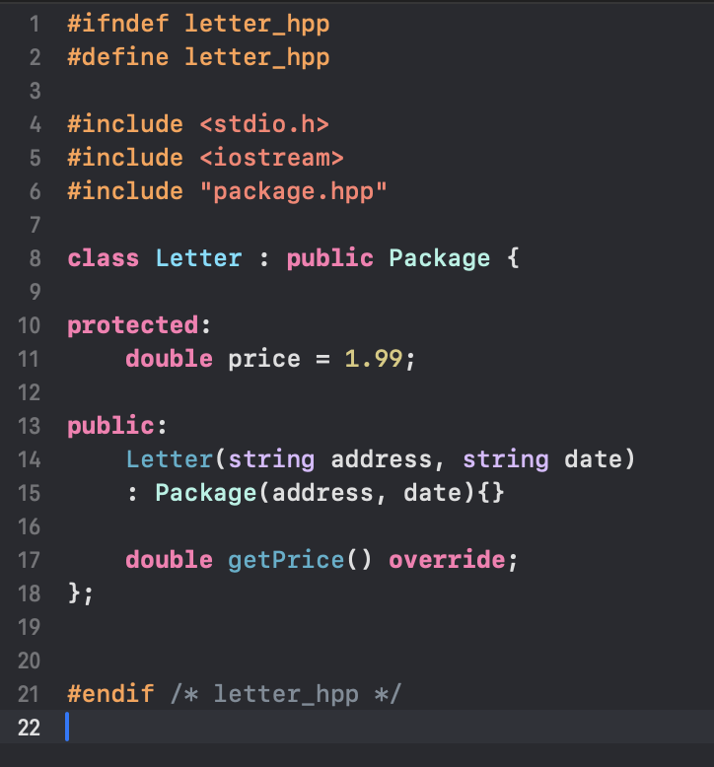
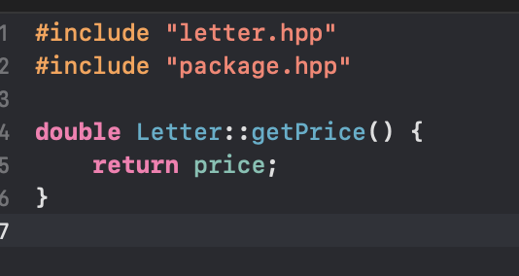
C++ files - Letter
a .HPP file
a .CPP file

Slide 7
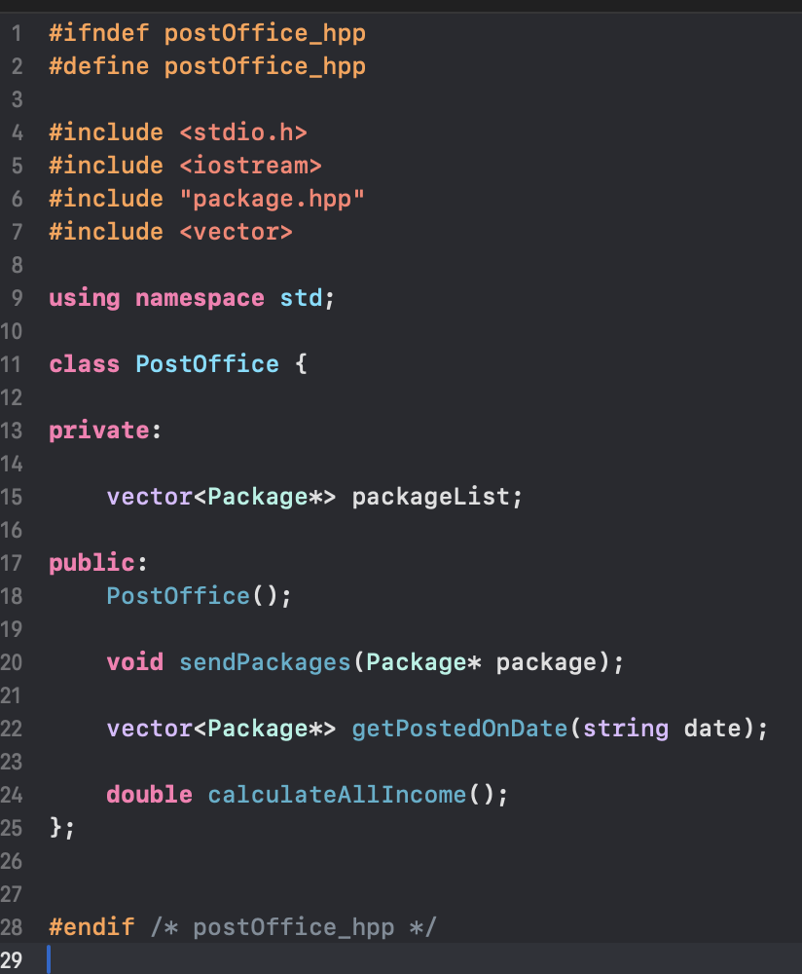
C++ files – PostOffice
a .HPP file
The pointers
Pointers are used to store memory addresses of objects,
This is useful when you want to work with dynamically allocated objects

Slide 8
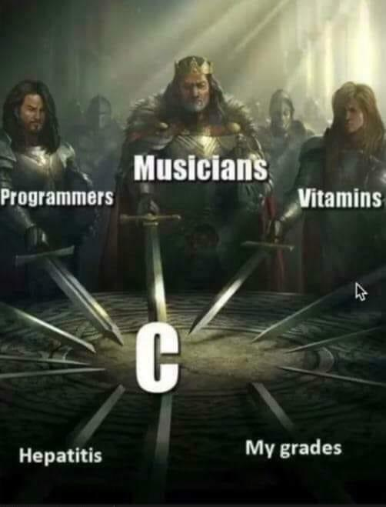
Thanks
Does anyone have any questions?
Please keep this slide for attribution

